Slide 1

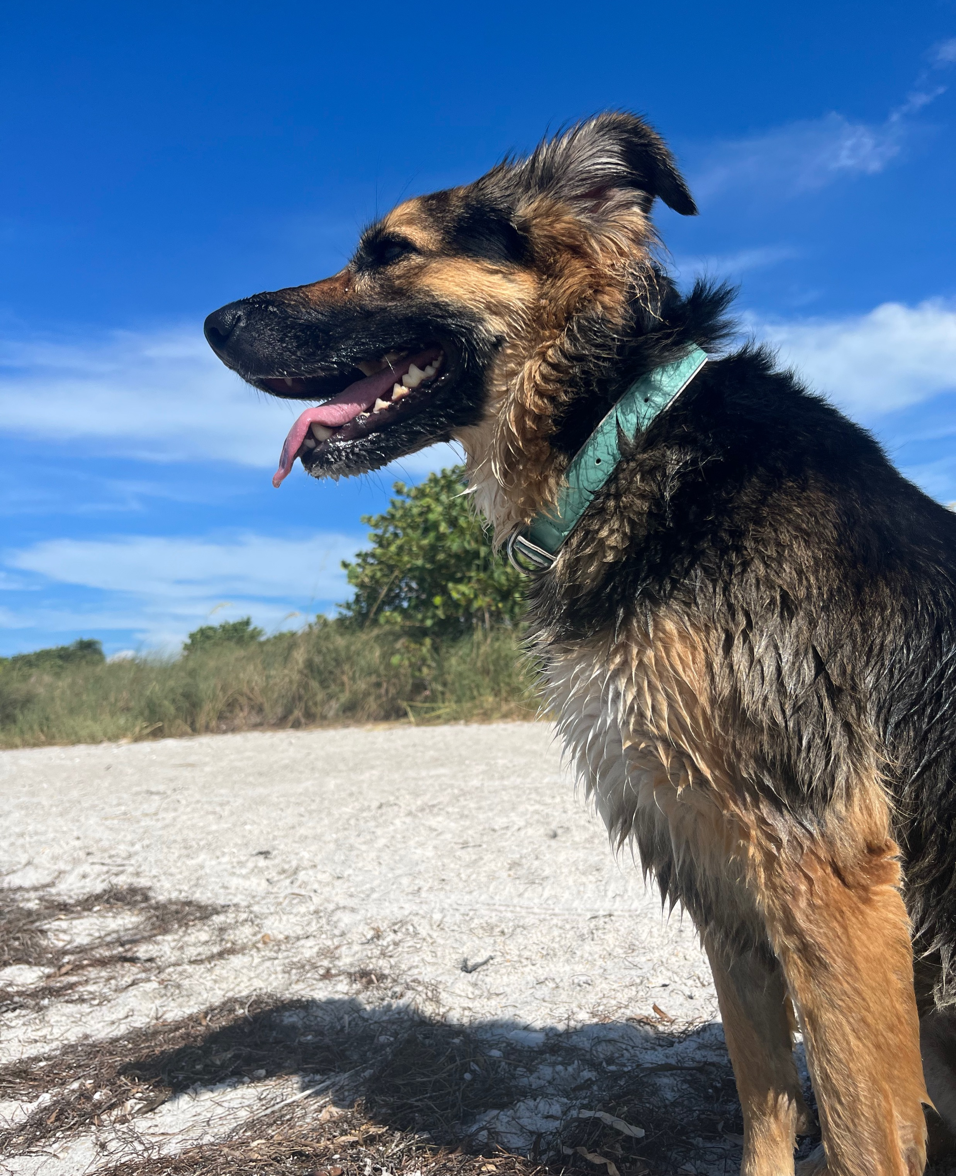

Predicting skin symptoms on dogs
Project by: Andrea Ternera

Slide 2
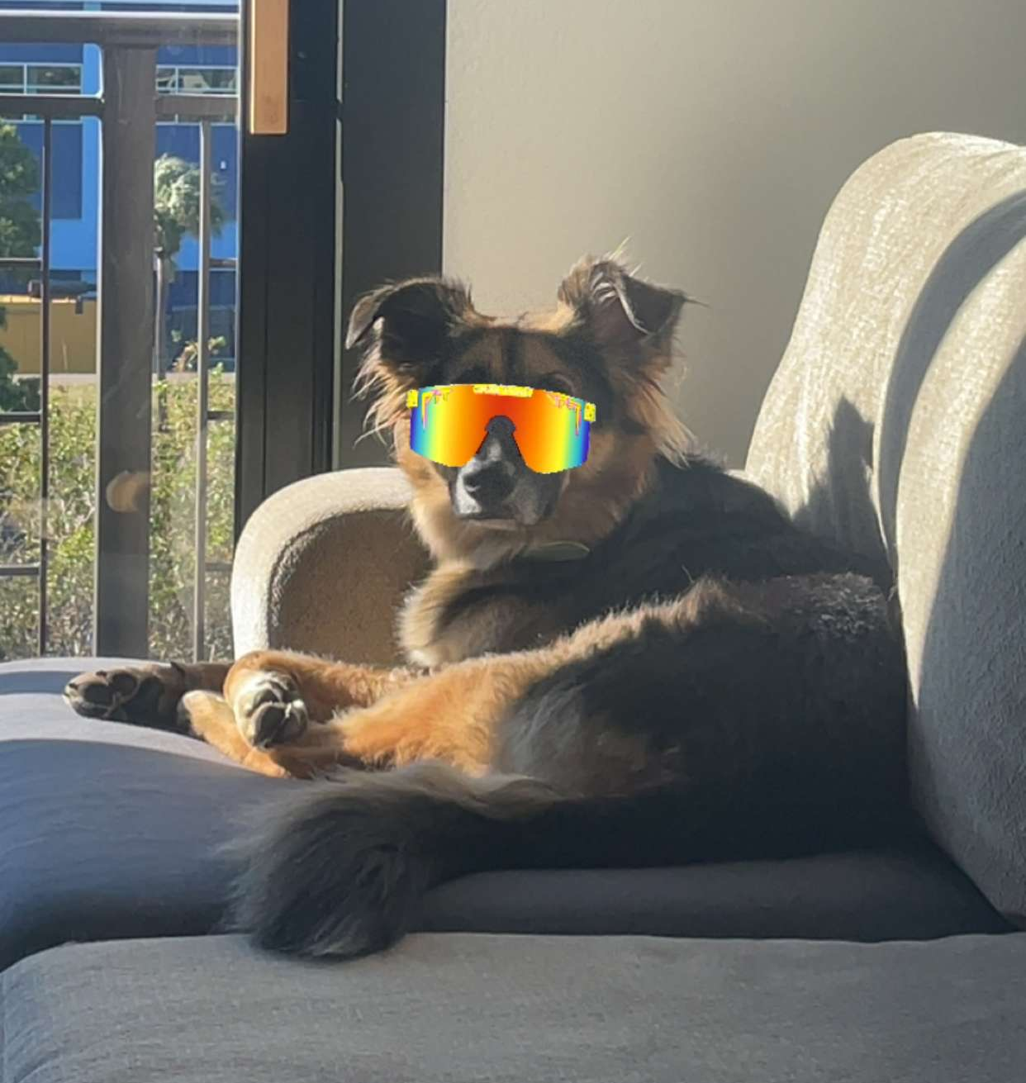


How much do dog owners spend on average?
Most owners spent an average of $40 to $290 per month on their dogs
An average of $480 to $3,470 annually.
It varies depending on a dog's individual needs, size, pet insurance plan's costs, and health status.
When it comes to the vet?
Pet insurance premiums can range between $360-$720 annually.
Sick and emergency veterinary visits can cost an owner between $150-$1,200 per visit.
Potential treatment costs for skin conditions can go up to $4,100.
*https://www.marketwatch.com/guides/insurance-services/cost-of-owning-a-dog
** https://www.thisoldhouse.com/home-finances/reviews/cost-of-owning-a-dog

Slide 3
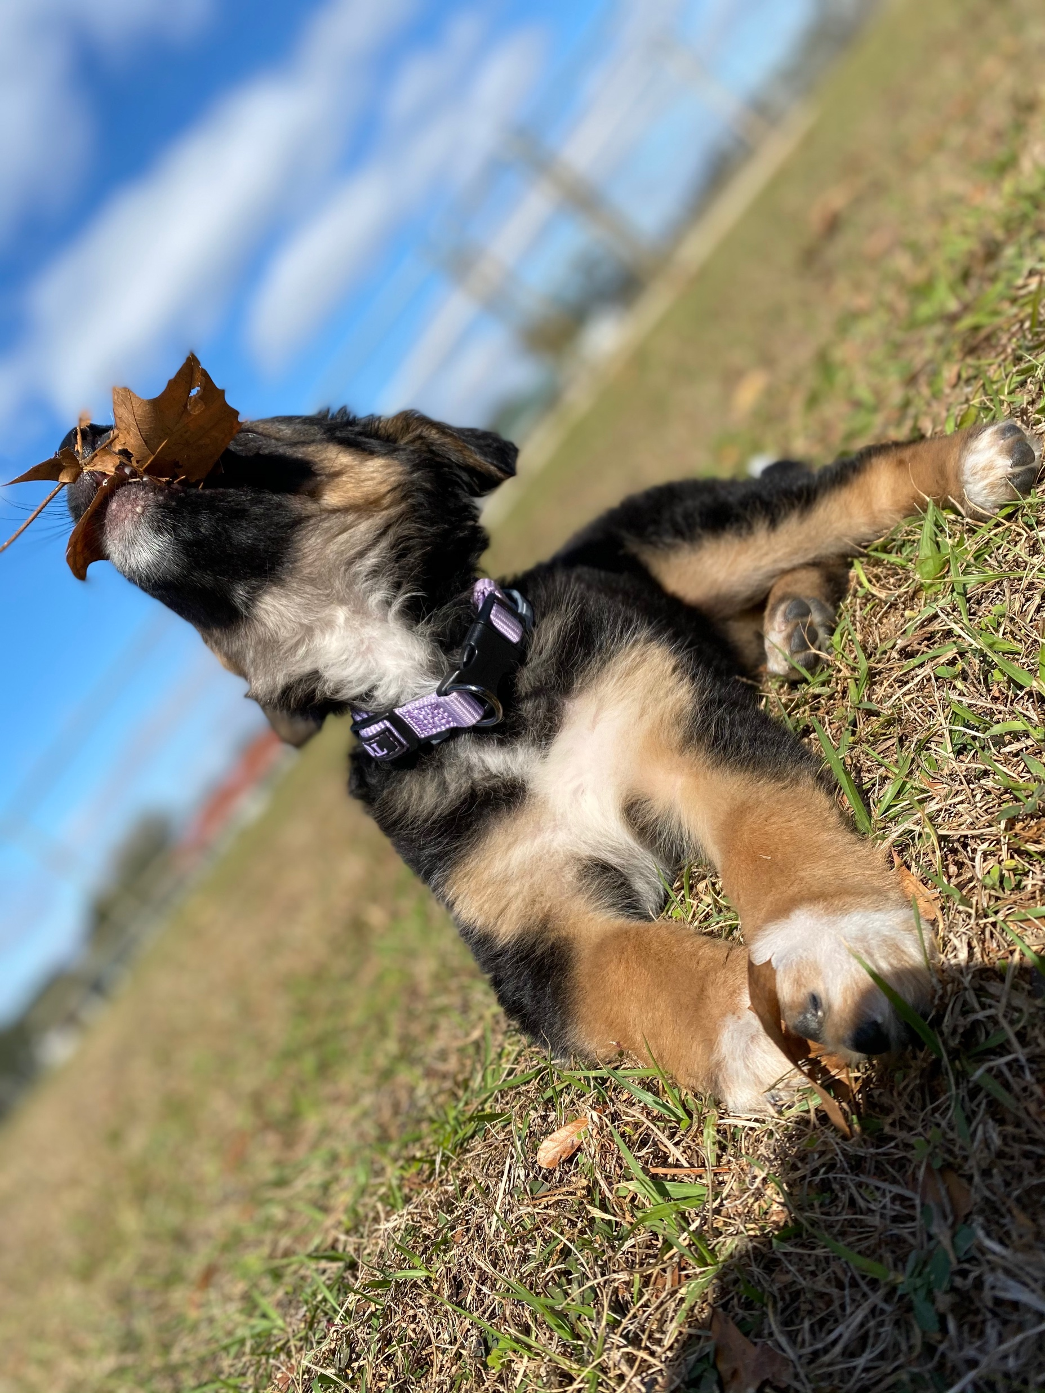
What we want to know:
Do environmental factors as well as specific dog characteristics increase the likelihood of a dog developing skin conditions?
Is it mostly or only hereditary?
Are certain breeds more prone to these skin conditions including canine atopic dermatitis (non-hereditary)?
Can we identify and communicate the risks as well as provide recommended living conditions for owners to help their dogs? thus, prevent emergency vet visits and treatment cost.

Slide 4
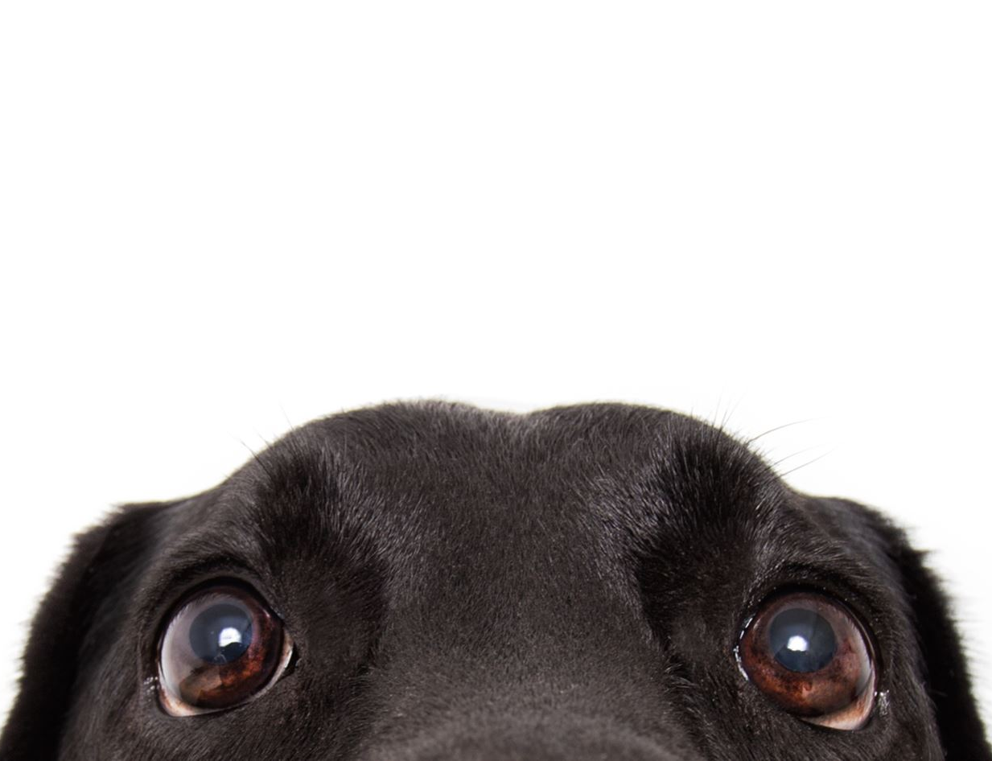
Obtaining the data
To complete this project, the following datasets were downloaded to local drive (from):
Data_Environmentandskinsymptoms.xlsx (figshare.com)
8644 rows/ 26 columns
medical and environmental records of dogs.
Dog_intelligence.csv (kaggle.com)
136 rows/ 5 columns
specific information for each breed intelligence and classification.
Best-in-show.csv (kaggle.com)
150 rows/5 columns
basic information for each dog breed such as high and low height in inches, and high and low weigh in lbs.

Slide 5
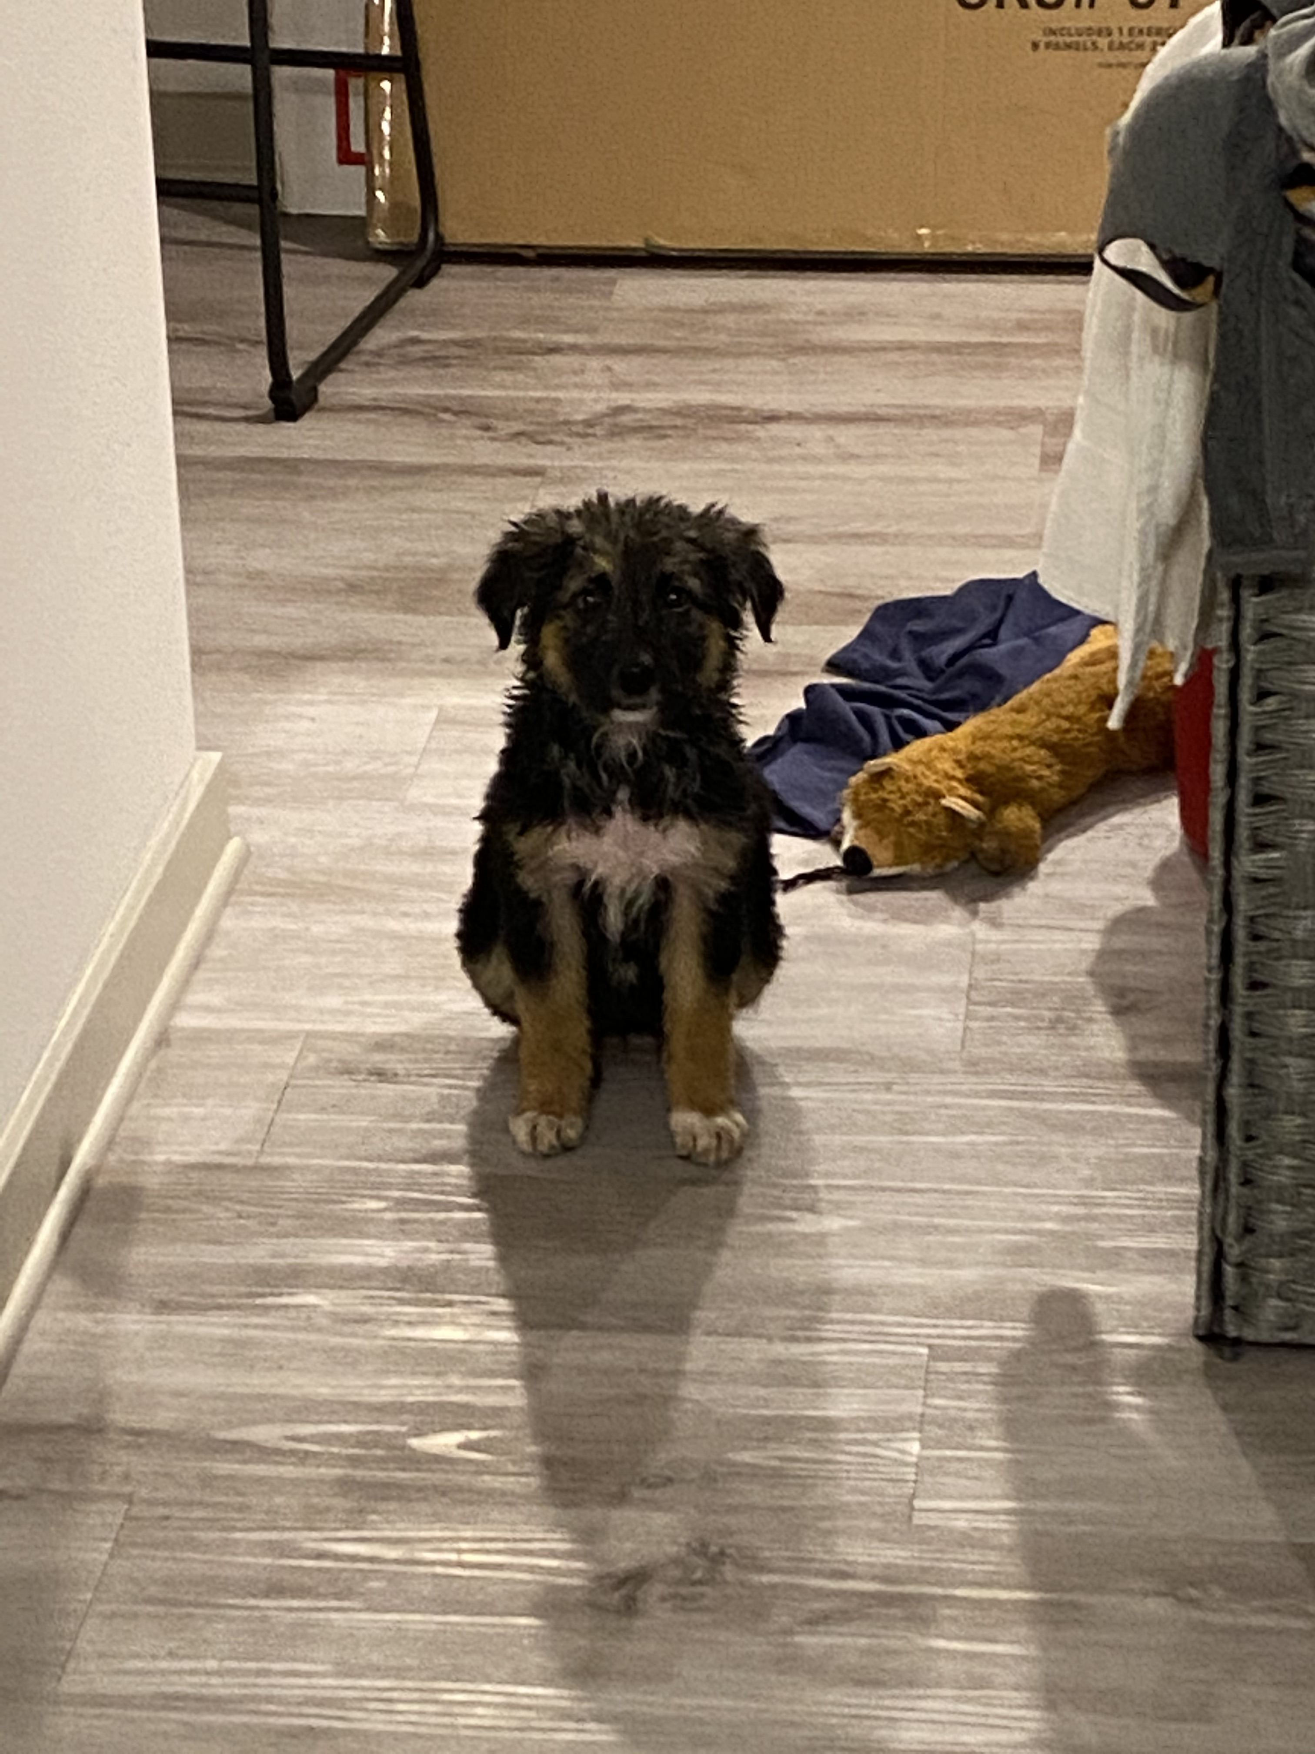
Cleaning steps
Translation:
Breed in the dataset were in Finnish
Missing values:
Columns with over 50% missing values in original EnvironementSkin df:
Dam_vaccinated_prebirth (72%)
1241 records were a Yes, and 1160 were a No.
*Given the almost 50-50 diff in values we filled all NaN values in this column with 50-50 0 and 1.*
Skin symptoms_dam (66%)
Smoking_previously (65%)
Dam_dewormed_prebirth (53% missing values)
Dropped rows:
Where all values of the 4 columns above were missing.
Dropped columns:
Id and Fci dropped due to being unnecessary for this project.
Smoking_previously due to:
high number of NaN values
high discrepancy between possible values
Cleaned data : 5265 rows / 33 columns.
Notes:
(Uralic language of the Finnic branch, spoken by most in Finland).

Slide 6
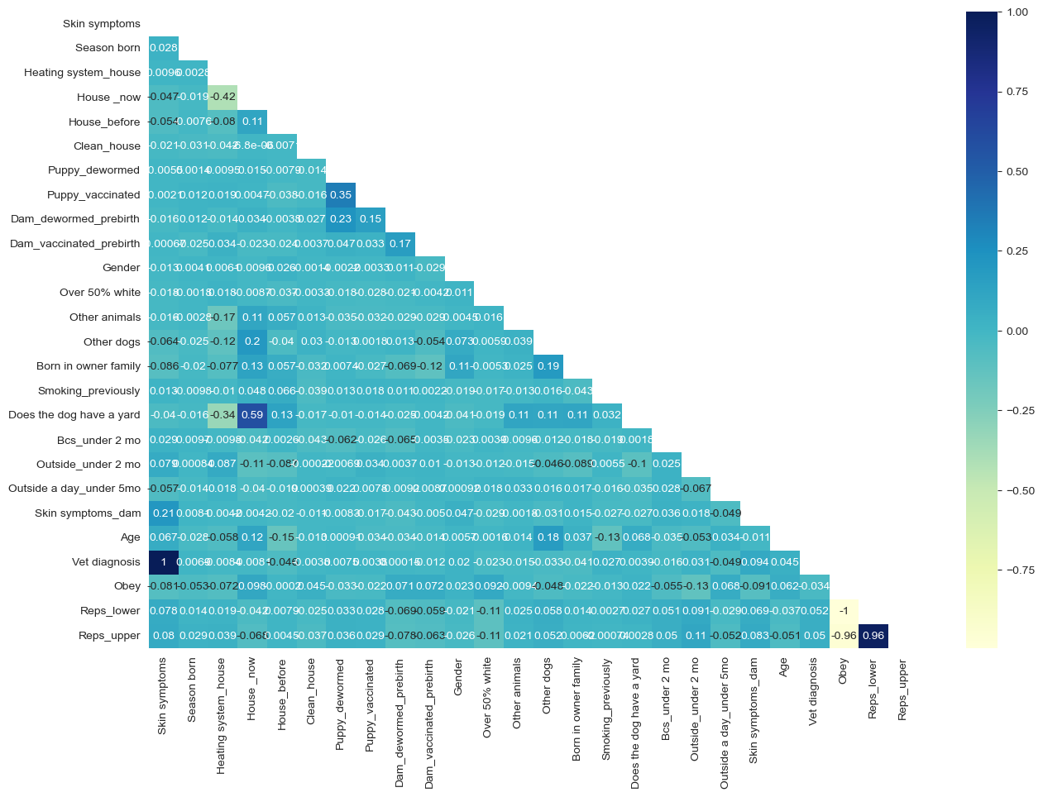
Exploratory data analysis
Most common breed:
Multiracial
German Shepherd
Labrador Retriever
Rottweiler
Finnish Lapphund
Total 202 breeds.
8/33 columns with over 50% missing values.
80% of the data is provided as categorical and binary values.
Average age of dogs in set: 3.9 years.
Dogs with skin symptoms:
Visible in older years within their category or classification.
Herding dogs have an older population of dogs as well as one of the largest distributions for positive skin symptoms.

Slide 7
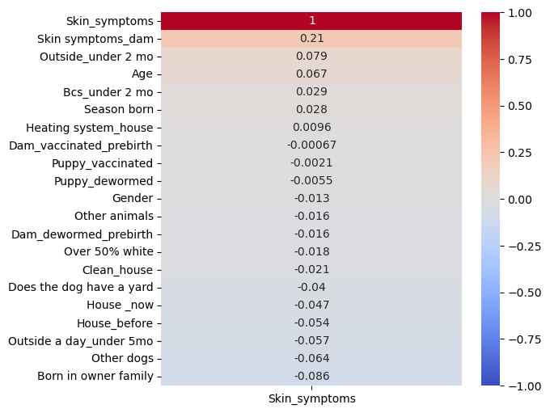
target FEATURE
Skin symptoms
Yes: 933
No: 4332
Highest positive correlations:
Skin symptoms dam
Outside under 2 months
Age
Characteristics for analysis divided into 4 categories:
Characteristics of dam (puppy’s mom)
Characteristics of puppy
Outside environment
House Environment

Slide 8
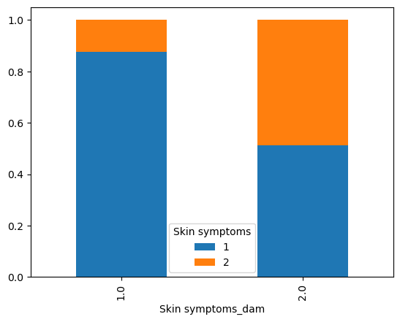
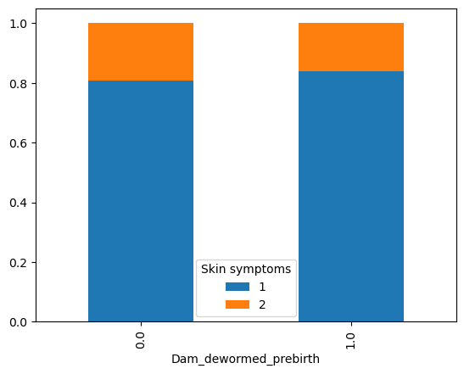
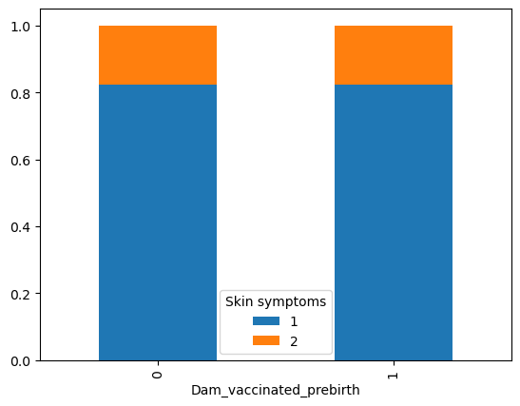
Characteristics of dam & skin symptoms
Skin symptoms present on dam:
Almost 3x the number of puppies of dams with skin symptoms also present skin symptoms.
65% positive skin symptom vs. 22% when dam does not have skin symptom.
Dam dewormed:
No significant impact on the puppy's skin symptoms if the dam is dewormed before birth.
~ 4% decrease.
Dam vaccinated
Virtually equal regardless

Slide 9
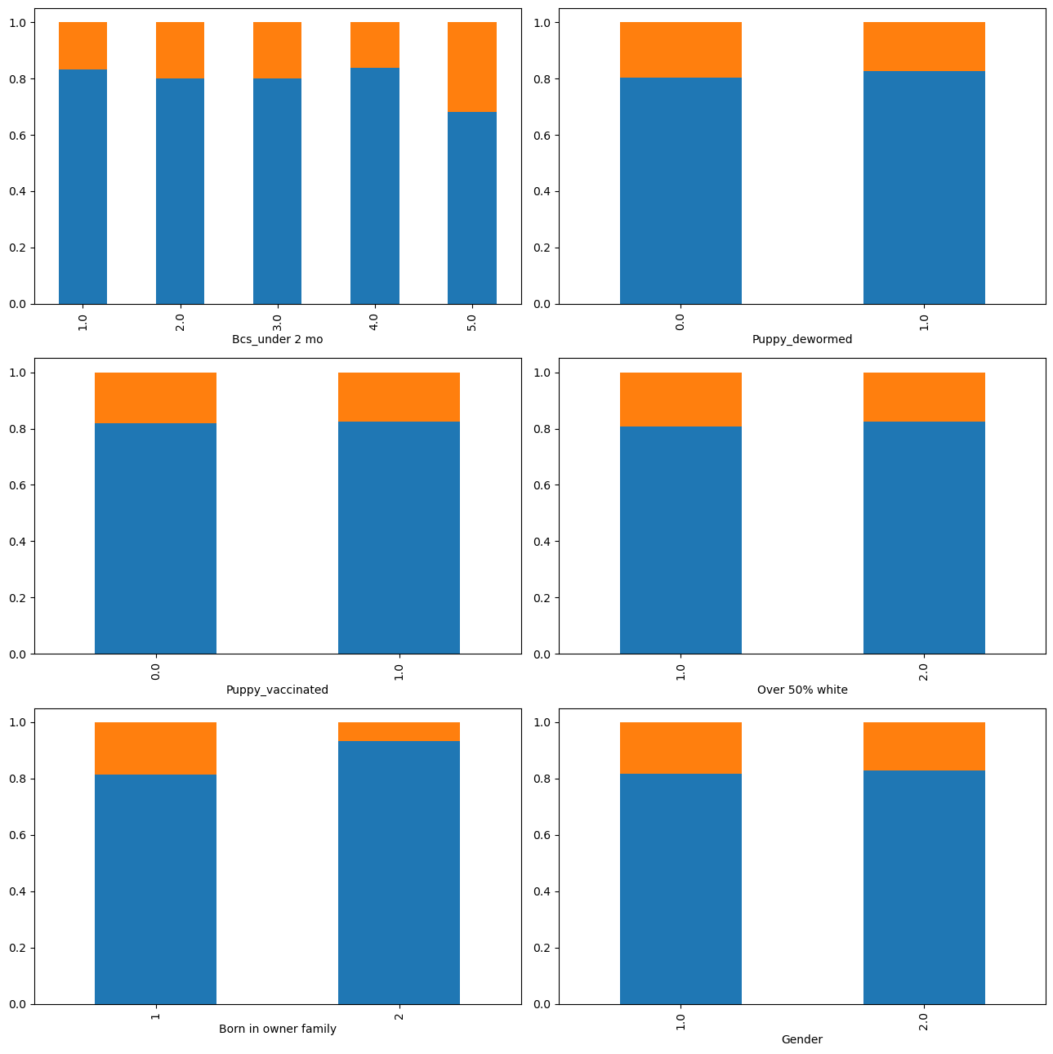
Characteristics of puppy & skin symptoms
Characteristics of puppy include:
Bcs under 2 months (weight)
Dewormed
Vaccinated
Over 50% white
Born in owner family
Gender
Relevant observations:
No effect:
Puppy being dewormed or vaccinated
Over 50% white or gender.
Some effect:
BCS (body condition score) when the puppy has a 5 BCS which refers to "Very Slim".
Not born in owner's family has 18.7% more cases.

Slide 10
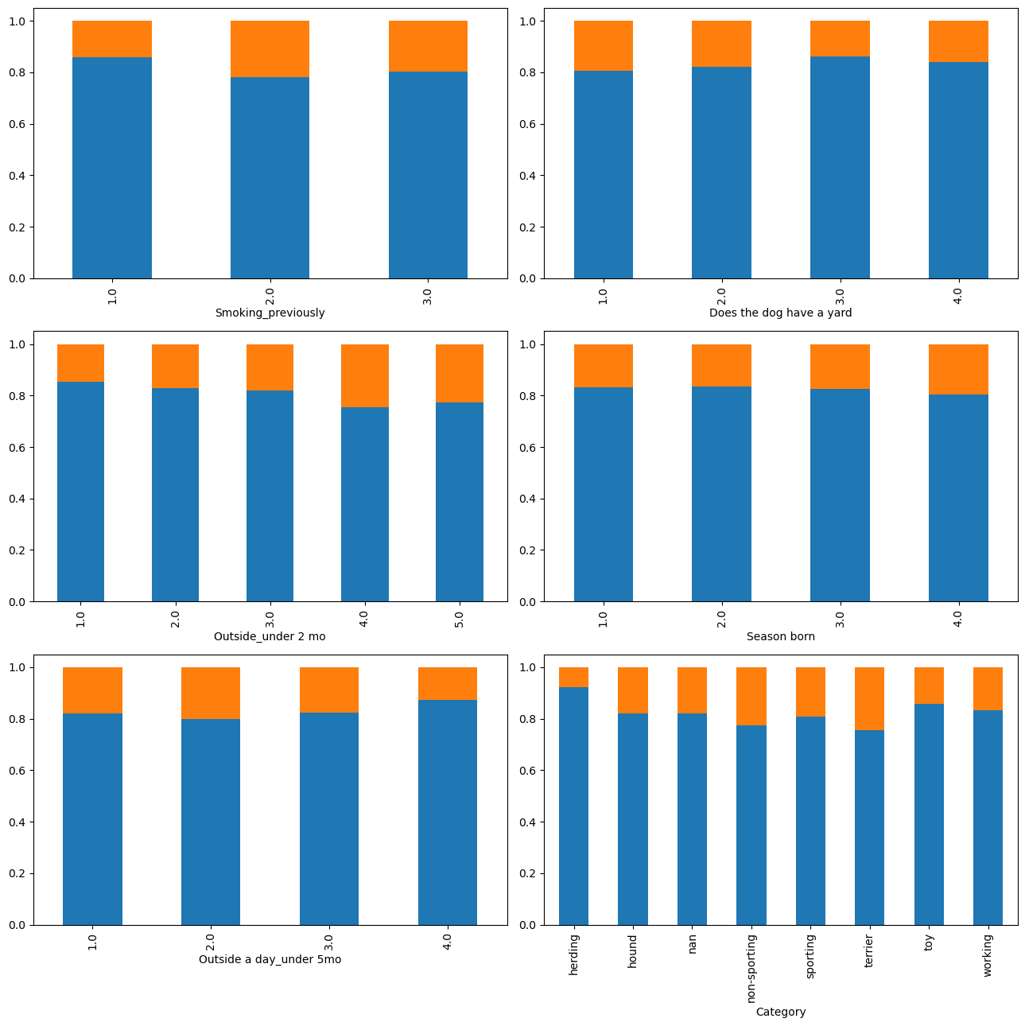
Outside environment & skin symptoms
Outside environment:
Smoking previously
Yard
Outside under 2 months
Season born
Outside a day under 5 months
Category
Relevant observations:
Category
Herding has least positive skin symptoms at 14%.
Toy and Working right below 29% followed by Hound.
Terrier and non-sporting have the highest cases at over 35% each.
Terrier with the highest from all categories at 39.3%

Slide 11
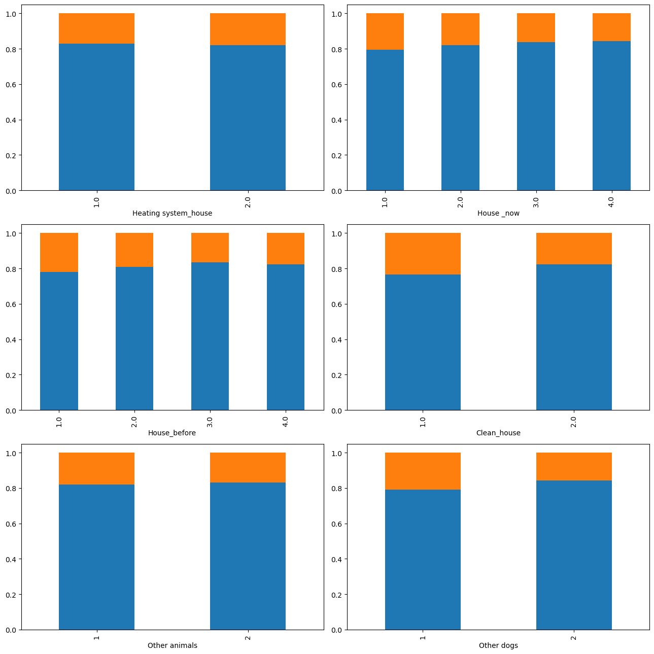
House environment & skin symptoms
House environment:
Heating system
House now
House before
Clean house
Other animals
Other dogs
Relevant observations:
Very small variability or correlation with skin symptoms.
A cleaner house and having other dogs seem slightly show less cases of positive skin symptoms.

Slide 12
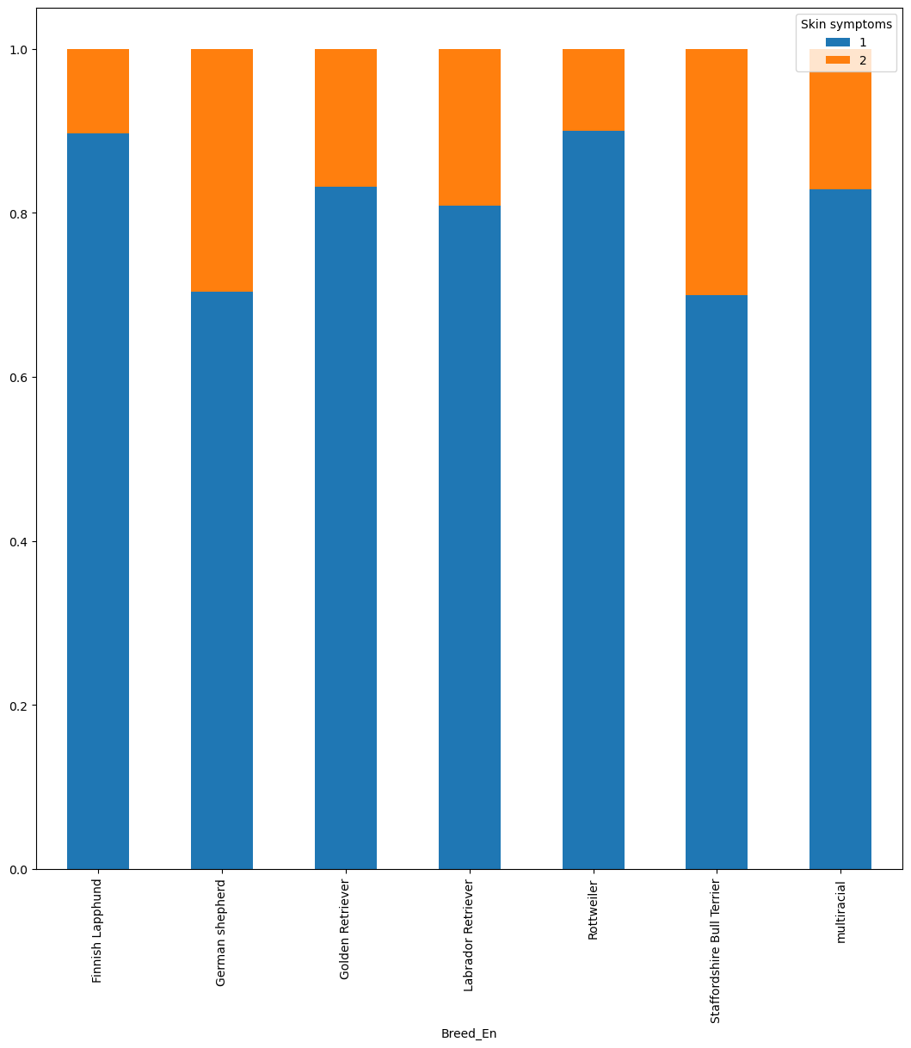
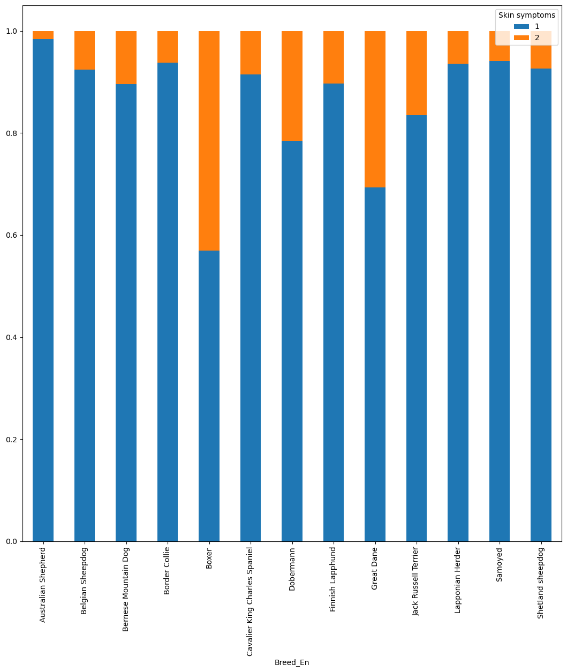
bREED & SKIN SYMPTOMS
Observations:
20-25% cases of skin symptoms :
German Shepperd
Staffordshire Bull Terrier
Doberman
Great Dane
Chinese Crested
French Bulldog
Parson Russellian Terrier
Boxer shows over 40% of records with skin symptoms.
Australian shepherd and shorthaired Collie have less than 10% recorded positive skin symptoms.

Slide 13
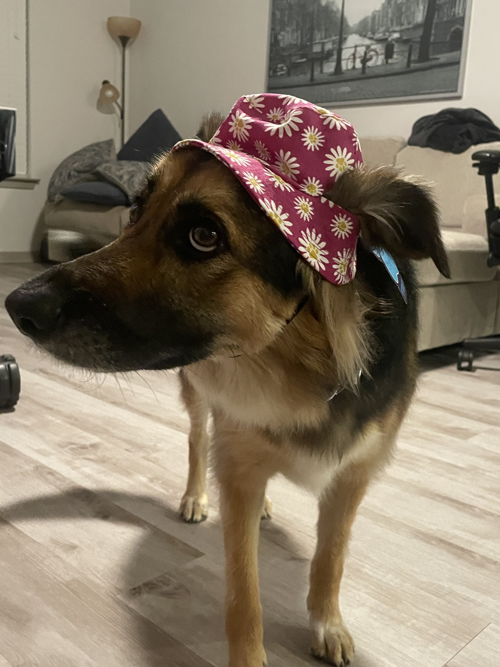
TRAINING-TESTING-MODEL
Using pd.get_dummies, we transformed the dataset to allow better visibility and information on categorical and binary variables.
We used dummy_na=True to maintain a count of missing/null values rather than imputing them with mode.
Hot encoded dataset = 5265 rows and 78 columns
Correlation between features remained the same as original dataset.
Split:
75% train (3948 – 74 columns)
25% test (1317 – 74 columns)
Split was done twice (with and without stratifying the data).
Age feature had 54 missing values that were filled with the feature’s mean of 3.9
3 Models:
Logistic Regression
Random Forest Classifier
KNeighbors Classifier
All models performed better with the stratified split

Slide 14

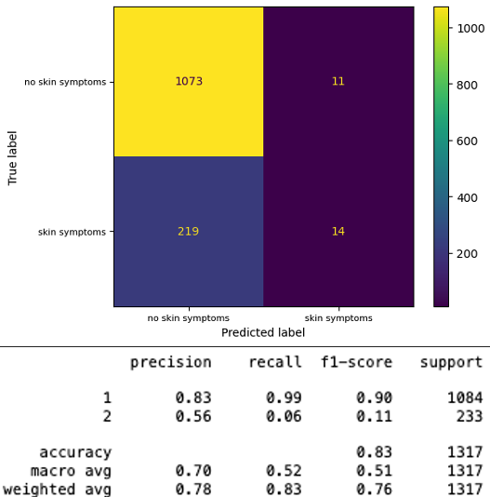
model Selection
Logistic Regression
The overall accuracy is 83%
When we predict skin condition:
44% of the time we are predicting a false positive.
17% of the time we are predicting a false negative.

Slide 15

Model selection CONT’
Random Forest Classifier
With stratified split, the precision of NO skin symptoms worsens by 11%
When we predict skin condition:
58% of the time we are predicting a false positive.
17% of the time we are predicting a false negative (just as well as logistic regression model).
Variable importance based on this model:
Age
House now 3 (detached wood)
Classification
Season born 1 (winter)
Category
Breed

Slide 16

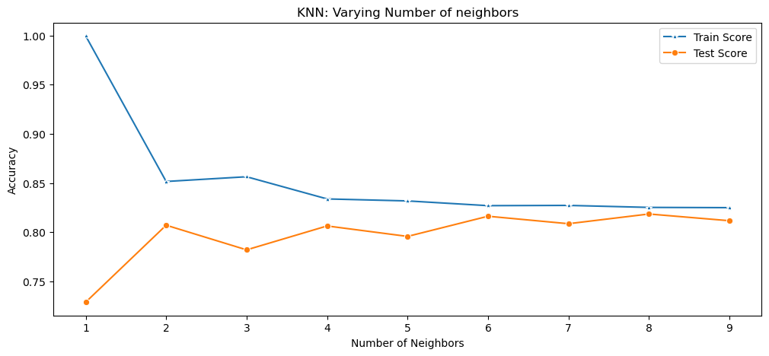
Model selection CONT’
Kneighbors Classifier
Worst performing model
When we predict skin condition:
87.5% of the time we are predicting a false positive.
17.8% of the time we are predicting a false negative (very similar to the other models).

Slide 17
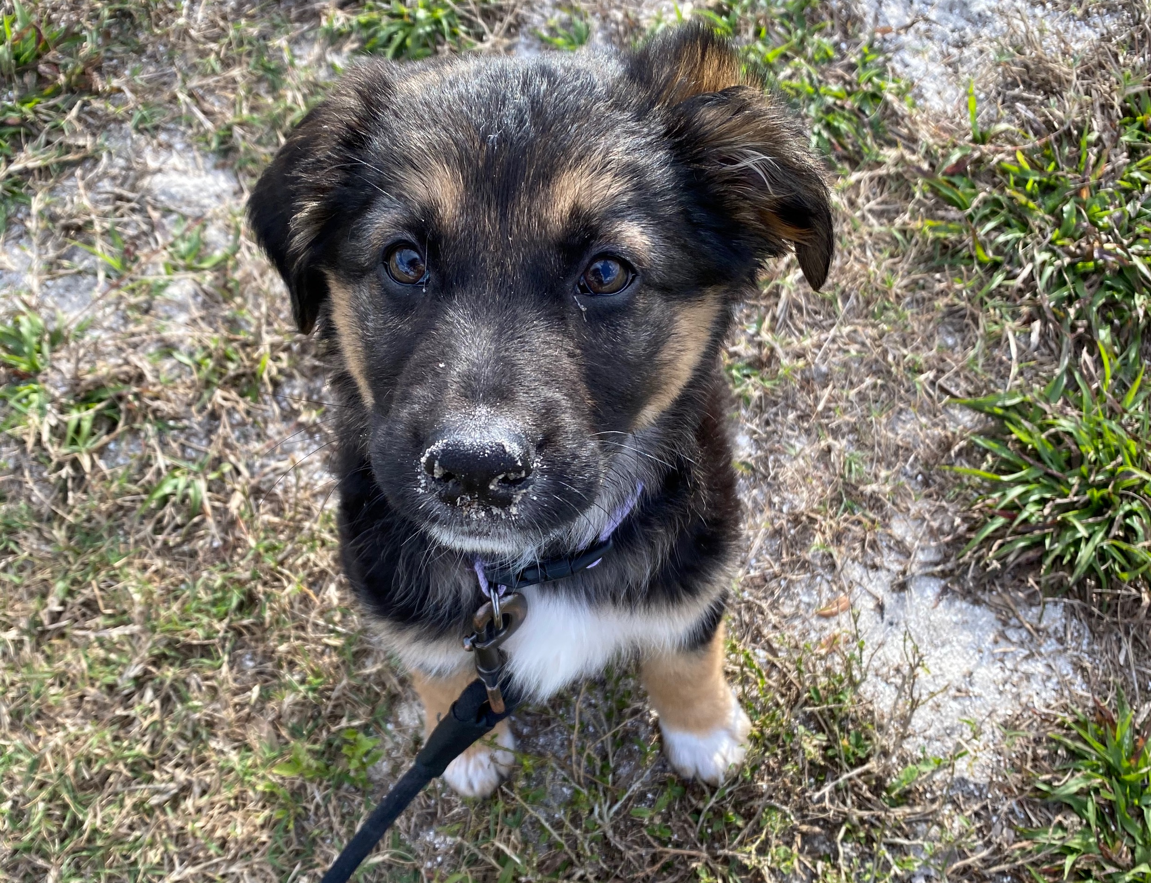
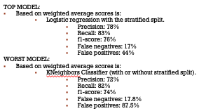
Conclusion
Stratified > not stratified split
Low performance - correctly predicting positive skin symptoms.
Significantly well - correctly predicting NO skin symptoms.
The overall accuracy of the models ranged between 80- 83%
Given the class imbalance in our problem, we might need to:
Gather more information, ideally of such cases where the pup DOES present skin symptoms.
Decrease set size to balance classes before split and training occurs.
More models with less features.
This information can be discussed to decide which is more important: Reducing false positives or false negatives, assuming overall accuracy is acceptable.

